Slide 1
Git Branching Example
Created on Win7 Laptop: 11/25/2016

Slide 2
Background
Before branching, the content was a series of text files that would not have completely matched Markdown format
After branching, edits were made to all content text files to create a first draft that should be valid markdown syntax. All files were also changed from .txt to .md
These slides show commands to set up the branch and switch between branches and illustrate these differences
Finally – slides show the commands to merge the ranches thus replacing original .txt draft with newer branch that is .md

Slide 3
Commands to set up and switch to new branch
Mitch@Win7-PC MINGW64 ~/Documents/Git_Repo/DevEnv-SetUp-Help (master)
$ git branch
* master
Mitch@Win7-PC MINGW64 ~/Documents/Git_Repo/DevEnv-SetUp-Help (master)
$ git branch contentAsMarkdown
Mitch@Win7-PC MINGW64 ~/Documents/Git_Repo/DevEnv-SetUp-Help (master)
$ git branch
contentAsMarkdown
* master
Mitch@Win7-PC MINGW64 ~/Documents/Git_Repo/DevEnv-SetUp-Help (master)
$ git checkout contentAsMarkdown
Switched to branch 'contentAsMarkdown'

Slide 4
Git Status: Shows some of the changes made
This output of Git Status shows changes made to our files on the new branch. Status command is used after “add” but before “commit” to show what changes will be committed to the branch.
Mitch@Win7-PC MINGW64 ~/Documents/Git_Repo/DevEnv-SetUp-Help (contentAsMarkdown)
$ git status
On branch contentAsMarkdown
Changes not staged for commit:
(use "git add/rm <file>..." to update what will be committed)
(use "git checkout -- <file>..." to discard changes in working directory)
deleted: GitHub_win7/GitHub_Basic_Commands_and_ScratchNotes.txt
deleted: GitHub_win7/GitHub_Intro_GetInfo_Commands.txt
deleted: GitHub_win7/GitHub_Intro_OtherUsefulCommands.txt
deleted: GitHub_win7/GitHub_Lesson1_SetupProject.txt
deleted: GitHub_win7/GitHub_Lesson2_InitializeExistingCodeProject.txt
deleted: GitHub_win7/GitHub_Lesson3_BranchingCommands.txt
deleted: GitHub_win7/GitHub_Lesson4_UndoingMistakes.txt
deleted: GitHub_win7/GitHub_Setup-Advanced_Work-w-Multiple-User-Accounts.txt
Untracked files:
(use "git add <file>..." to include in what will be committed)
GitHub_win7/GitHub_General-ScratchNotes-and-Help-Links.md
GitHub_win7/GitHub_Intro_GetInfo_Commands.md
GitHub_win7/GitHub_Intro_OtherUsefulCommands.md
GitHub_win7/GitHub_Lesson1_SetupProject.md
GitHub_win7/GitHub_Lesson2_InitializeExistingCodeProject.md
GitHub_win7/GitHub_Lesson3_BranchingCommands.md
GitHub_win7/GitHub_Lesson4_UndoingMistakes.md
GitHub_win7/GitHub_Setup-Advanced_Work-w-Multiple-User-Accounts.md
no changes added to commit (use "git add" and/or "git commit -a")

Slide 5
Git Status: Shows some of the changes made
After more editing … note that we change .gitignore file adding “~*.* so Git will ignore temp files from Microsoft Office
Mitch@Win7-PC MINGW64 ~/Documents/Git_Repo/DevEnv-SetUp-Help (contentAsMarkdown)
$ git branch
* contentAsMarkdown
master
Mitch@Win7-PC MINGW64 ~/Documents/Git_Repo/DevEnv-SetUp-Help (contentAsMarkdown)
$ git status
On branch contentAsMarkdown
Untracked files:
(use "git add <file>..." to include in what will be committed)
GitHub_win7/Git Branching Example - Lesson3.pptx
GitHub_win7/~$Git Branching Example - Lesson3.pptx
nothing added to commit but untracked files present (use "git add" to track)
Mitch@Win7-PC MINGW64 ~/Documents/Git_Repo/DevEnv-SetUp-Help (contentAsMarkdown)
$ git status
On branch contentAsMarkdown
Changes not staged for commit:
(use "git add <file>..." to update what will be committed)
(use "git checkout -- <file>..." to discard changes in working directory)
modified: .gitignore
Untracked files:
(use "git add <file>..." to include in what will be committed)
GitHub_win7/Git Branching Example - Lesson3.pptx
no changes added to commit (use "git add" and/or "git commit -a")

Slide 6
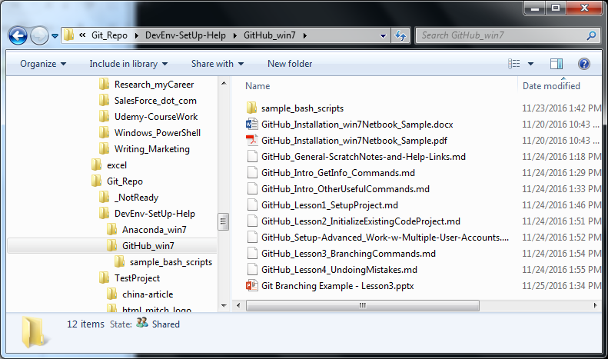
contentAsMarkDown Branch (has all working edits)
Now … use “git checkout master” to switch back to original branch …
This is just a test to illustrate the two branches

Slide 7
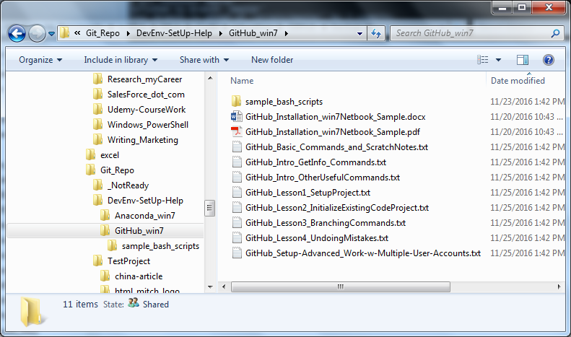
master Branch (content as it was before edits in new branch)
Now … use “git checkout contentAsMarkdown” to switch back to working branch (with all new edits) … This is just a test to illustrate the two branches

